Slide 1
Question #1: Design a golden master AMI build work-flow identifying the key stages, and suggest technologies which might be used to implement. Use of AWS native services is preferred
A golden image is simply an image that you have customized to your liking with all necessary software/data/configuration information ready to go and then saved as a personal AMI from which you can launch instances.
A golden AMI is an AMI that contains the latest security patches, software, configuration, and software agents that you need to install for logging, security maintenance, and performance monitoring
There are following native services and ways to build/trigger instances:
Lambda function to share Golden AMIs between regions, can also trigger CloudFormation stacks to update ASG’s with the new AMI
SNS topic for AMIs to be subscribed to by a lambda that can grab the new AMI ID and run the pipeline
We can triggered the CodePipeline from GitHub using WebHooks to build container images and run config scripts and creates a new AMI

Slide 2
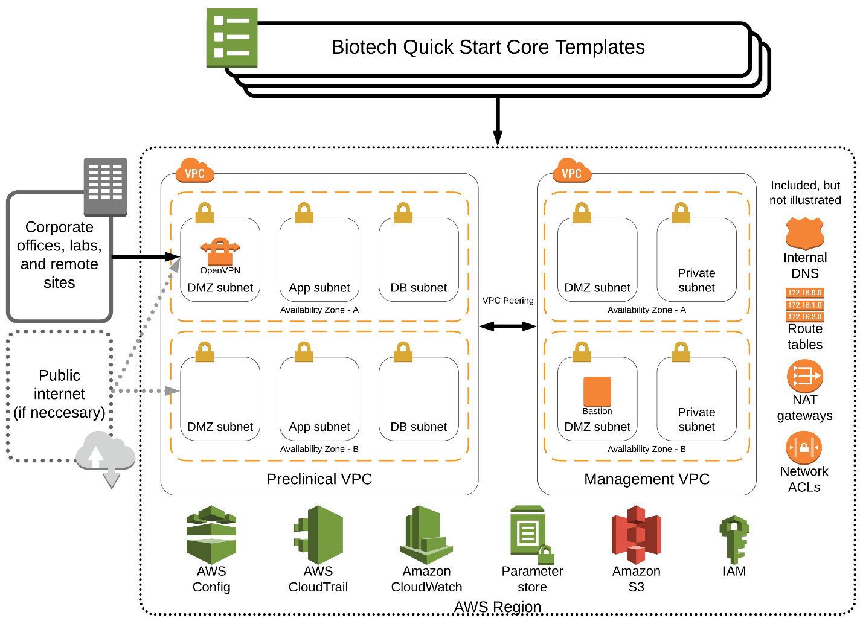
Question #2: Currently connectivity between AWS accounts and on premise networks are provided via peering and site-to-site vpn’s. Design a network topology that will allow scalable connectivity both across accounts and to on premise networks, and discuss:
- Network migration strategies.
- Security considerations and provisions.
Architecture :

Slide 3
We can setup mesh architecture along with Transit Gateway (one AWS Transit Gateway can shared between different accounts and VPCs through CloudFormation) to consolidate existing edge connectivity and route it through a single inbound/outbound point. We can design one VPC to control inbound/outbound connections to the internet, and use one internet gateway in the shared-services account.
Network Migration Strategy:
Create Transit gateway, and associate VPCs with Adding custom route tables as well as updating existing VPC routetables without disrupting network connections.
Establish the side by side connection with current peering and VPN connections
Test the connection and deploy in the new architecture
Disable the peering connections once test is successful and deployed.
Lastly, remove the peering routes and connections.
Security Considerations and provisions:
Multiple VPCs Inbound/Outbound points consolidated into one.
Rest all Security provisions for new networking architecture will remain same (NACLs, IAM will not be chnaged).

Slide 4
Question #3: Design an enterprise IAM solution to provide access to users, Applications, and services across the organization while ensuring controls are in place to ensure restrictions can be implemented on a least privileged requirement.
We can use below architecture or provision to provide access to all users across the organization:
User request can be validated with Microsoft AD or LDAP
We can configure SSO with Adaptive MFA
We can implement Micro-segmentation
SSO controls access by mapping different user groups to IAM roles with corresponding permissions based on least-privilege
Internal applications built on top of AWS can be configured to authenticate users through third party API or with Microsoft AD (Identity aware proxy)

